Slide 1
Barone2
Design Progress Review 1
Dylan Harootunian
Chin Ming Ryan Wong
Leonid Shuster
Jeremy Germenis
George Hernandez
Isaac Szu

Slide 2
Requirements
Power usage (1.1.1): Progress was made by finalizing and purchasing a microcontroller, microprocessor, and various sensors and determining power usage of each component
Drone effective weight system (2.0.0-2.2.2) : Progress was made on these requirements by designing a CAD model and making a weight budget
RC Control (3.0.0): Progress was made by finalizing and purchasing a microcontroller, microprocessor, and various sensors
Software component of system response for RC control (3.1.2): progress was made by designing the software implementation of system response
Autonomous Controls Systems (4.0.0): Progress was made by determining and purchasing the exact microcontroller, microprocessor, and sensors used for autonomous control
Cost (5.1.0, 5.3.0): Progress was made by keeping the BoM up to date with new materials and microcontroller, microprocessor, and sensors bought
Drone Safety (7.1.1, 7.1.2): Progress was made by the creation of the CAD design in solidworks

Slide 3
Milestones
Functional Design: Complete
Drone in Sim: Incomplete/Delayed
Purchasing microcontroller, microprocessor, and sensors: Complete

Slide 4
Non Detailed (First Draft) CAD Design
System technical requirement:
Drone effective weight:ALL (2.0.0-2.2.2)
Cost: Raw Material and manufacturing (5.1.0, 5.3.0)
Drone Safety: Body Design and propellers(7.1.1, 7.1.2)
Specifications:
The propellers should be placed as far from the gondola as feasible
Lift bag must be large enough to reduce the weight of the drone to <5N
Schematic: These CAD designs were based off schematics that where hand drawn in my engineering notebook, the sizes of the propellers and lift bag where decided based off initial analysis of the weight of the drone parts and the forces needed to lift them.
(more on this in the force analysis slide)

Slide 5
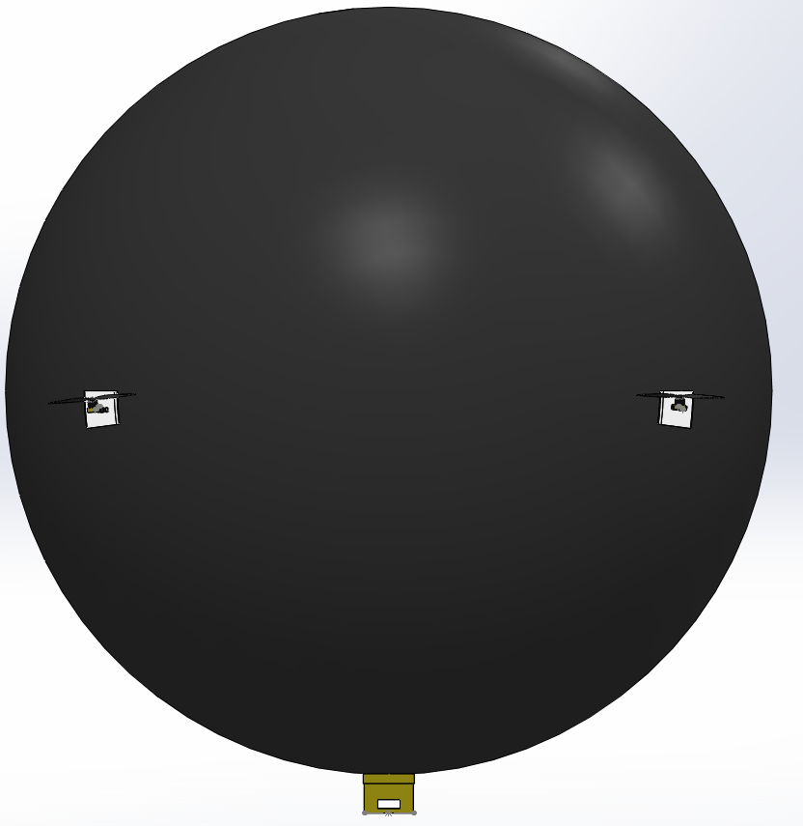
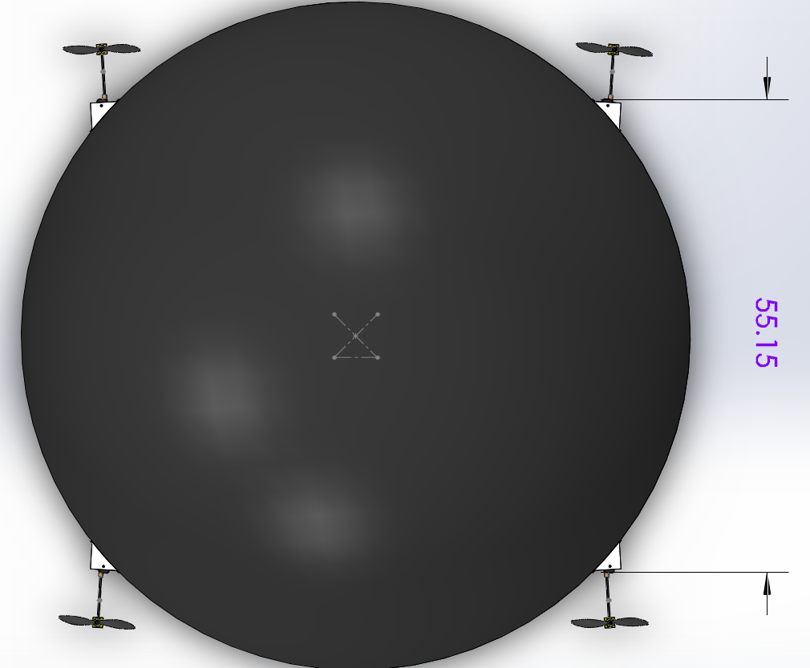
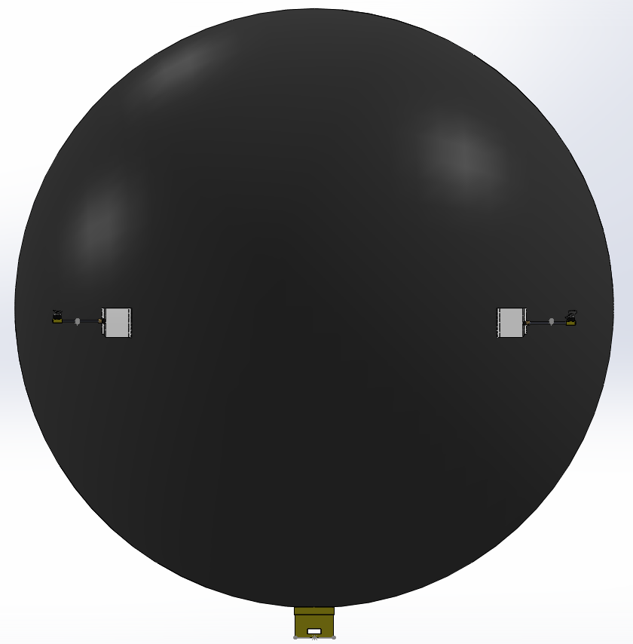
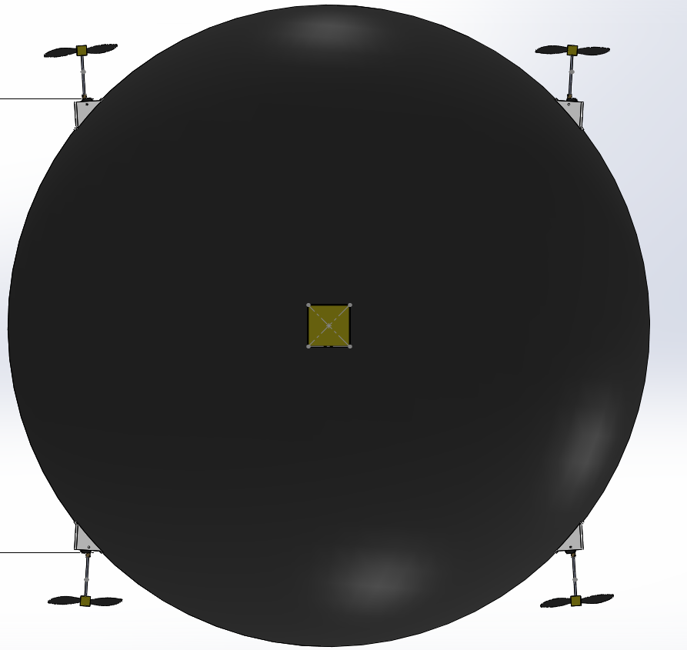
SIDE
TOP
4 propellers that sit equidistant from each other just below the center of buoyancy
These props are connected to servos that sit in connector parts that will be attached to the envelope
Gondola attached to the bottom that has rounded cuts so that it fits onto envelope
FRONT
BOTTOM
The envelope is not featured here but would be the same size as the balloon (In this design), and would be made of polyurethane or polyester sheets to act as a layer that the parts can connect too without affecting the integrity of the balloon

Slide 6
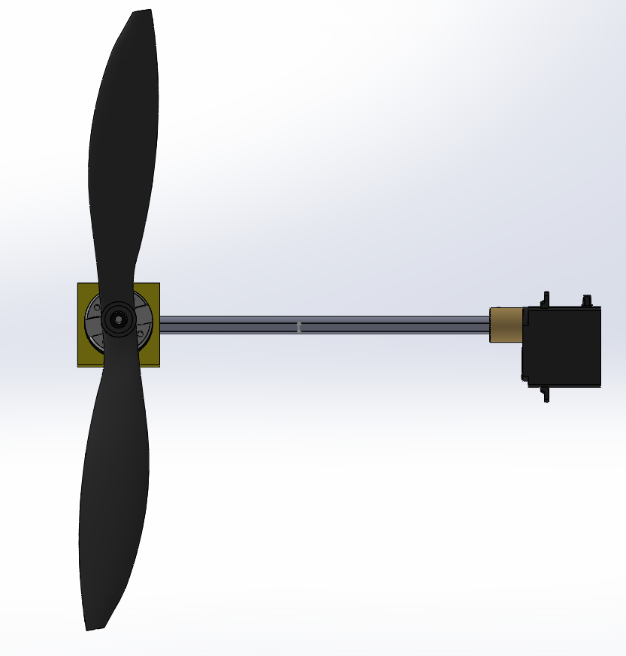
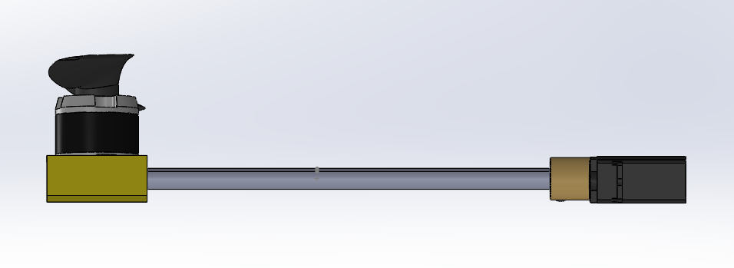
Servo Shaft
The yellow block that the motor is sitting on in this CAD will be a connector piece that attaches the motor to the shaft extension from the servo. Since the motor is not yet finalized, I used this placeholder part until a more permanent fitting can be made or found
Propellor blades are currently 9” which should provide enough lift assuming they are attached to a motor that provides sufficient torque
They sit at the end of a 6” shaft, so that they do not hit the envelope

Slide 7
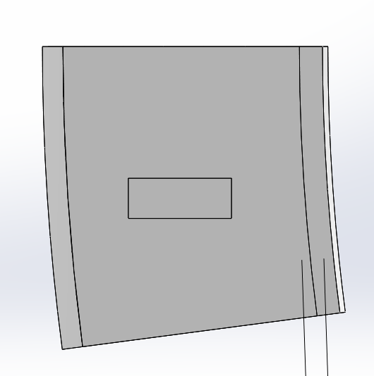
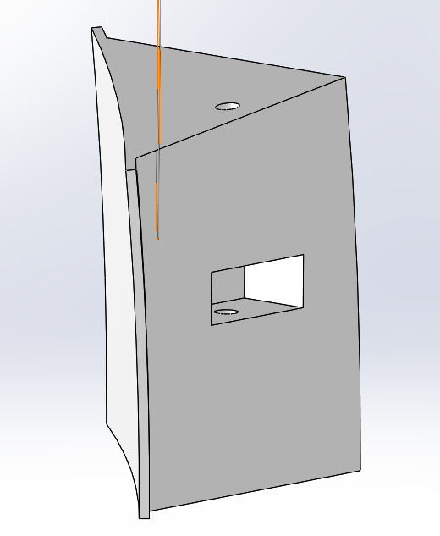
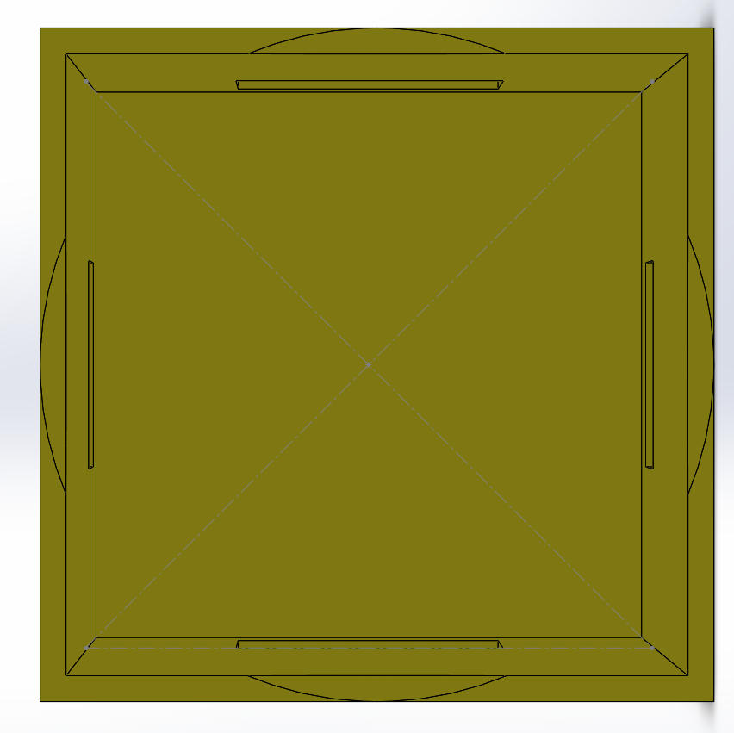
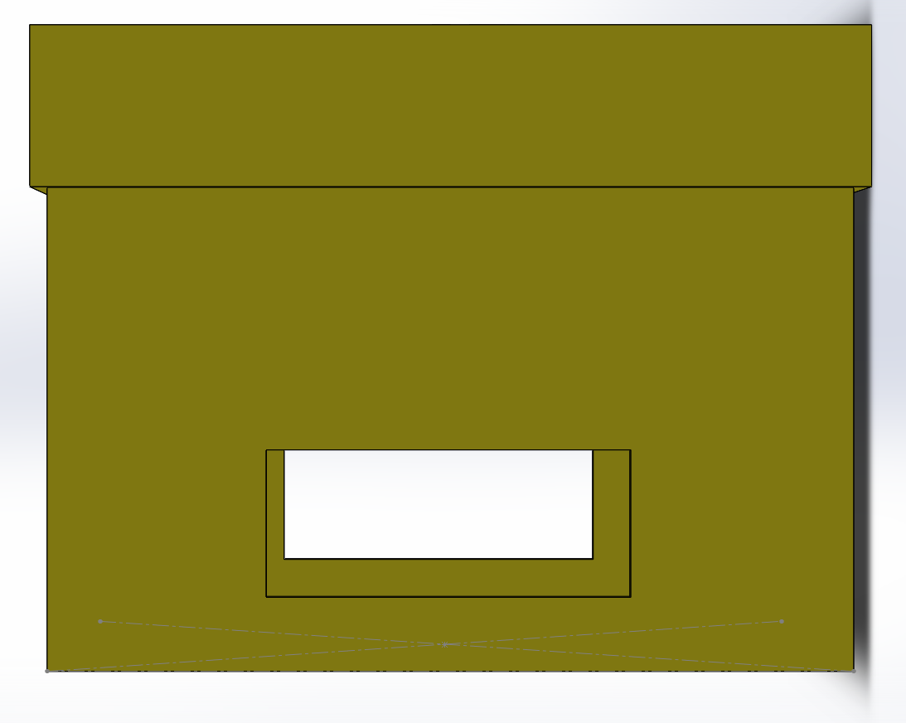
Attachment Parts
Since the envelope of the Barone will be a unique shape, it will be hard to find premade parts that will attach
These parts were designed small enough that they could be 3D printed, which will be useful for the custom shapes that will be required
Both the top of the gondola and the back of the servo connector are curved to the shape of the envelope.
Holes are cut into these parts to allow wires to be run in and out of them
The gondola will be modified in the future so that sensors such as the camera, and Mag-Aroe can be attached
The CAD models for many of the sensors and microcontrollers are downloaded but not yet placed in the gondola since the specifics of the layout are not yet decided

Slide 8
Improvements
The largest change that needs to be made is the shape of the envelope.
A shape that would be more aerodynamic is wanted to increase flight performance
A change in shape would mean a change to the curves on the servo attachments and the gondola
The gondola will need to have attachments on it to hang the Mag-Aero off of
These attachments will likely be eye screws
Carbon fiber tubes will also be attached to the eye screws that will hold mag aero
A slant will likely be required to put the camera at the angle that will be required
This part needs to go through a lot of stress testing since it will be holding the most weight.
Miscellaneous changes
The shaft in the CAD is an arbitrary DShaft and will likely be updated to match the part we order
Additional support will be added to the 6” DShaft since it will be bearing the weight of the motor
A part that mounts the motor 90° from the servo shaft will be CAD’d or downloaded once the motor is finalized.
The servo mounting block will likely be changed to insure structural integrity and to reduce weight

Slide 9
PCB Design
First design:
Custom PCB with Sensor IC chips, pinouts and microcontroller integrated
No excess breakout board, reduces weight
Will be hand soldered
PCB printed by third party (OSHPark)

Slide 10
System Technical Requirements: PCB
Autonomous Control > Path Following > GPS Sensor added
Autonomous Control > Terrain Tracking > Ultrasonic Sensors added
Autonomous Control > Error Handling> Accelerometer and Gyroscope sensor added
Outputted Interference measured by IMU sensor
Helium Leakage> Detect helium leakage>Pressure Sensor

Slide 11
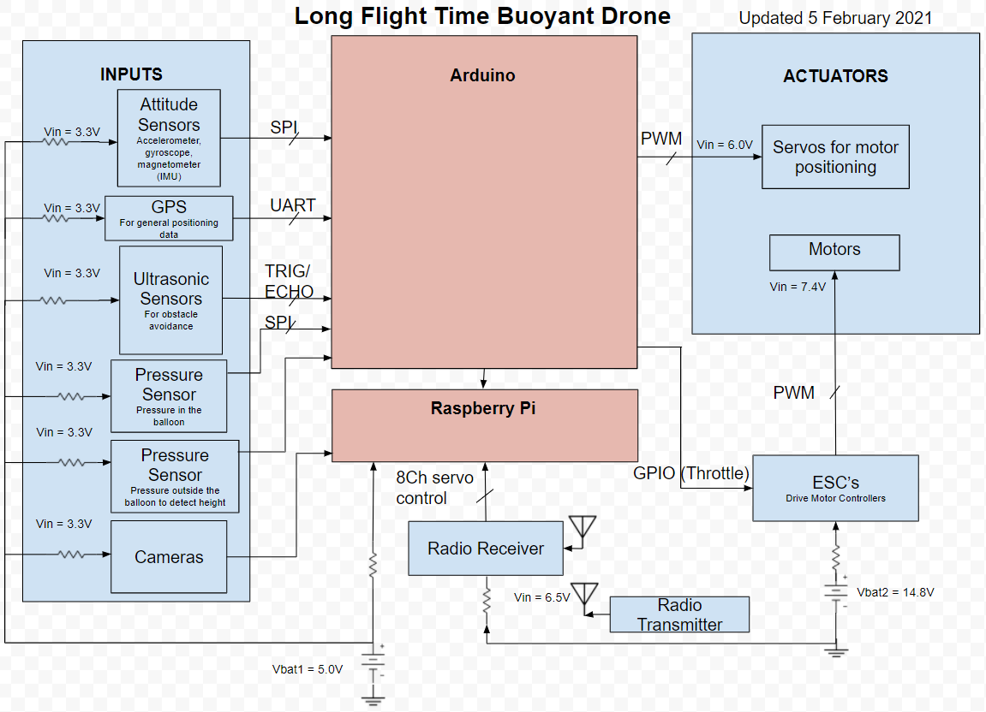

Slide 12
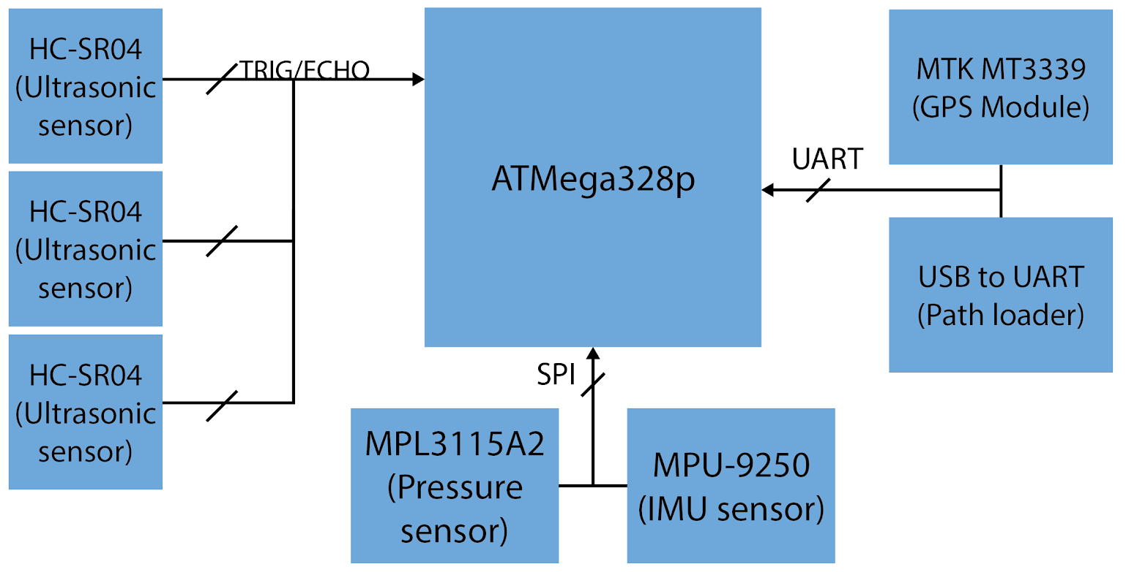
Implemented Block Diagram

Slide 13
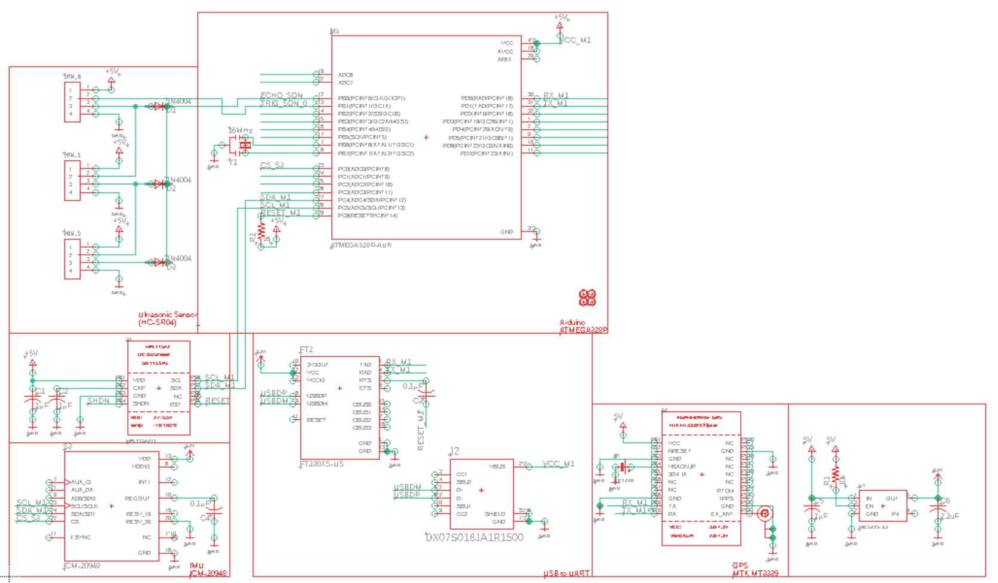
Schematic

Slide 14
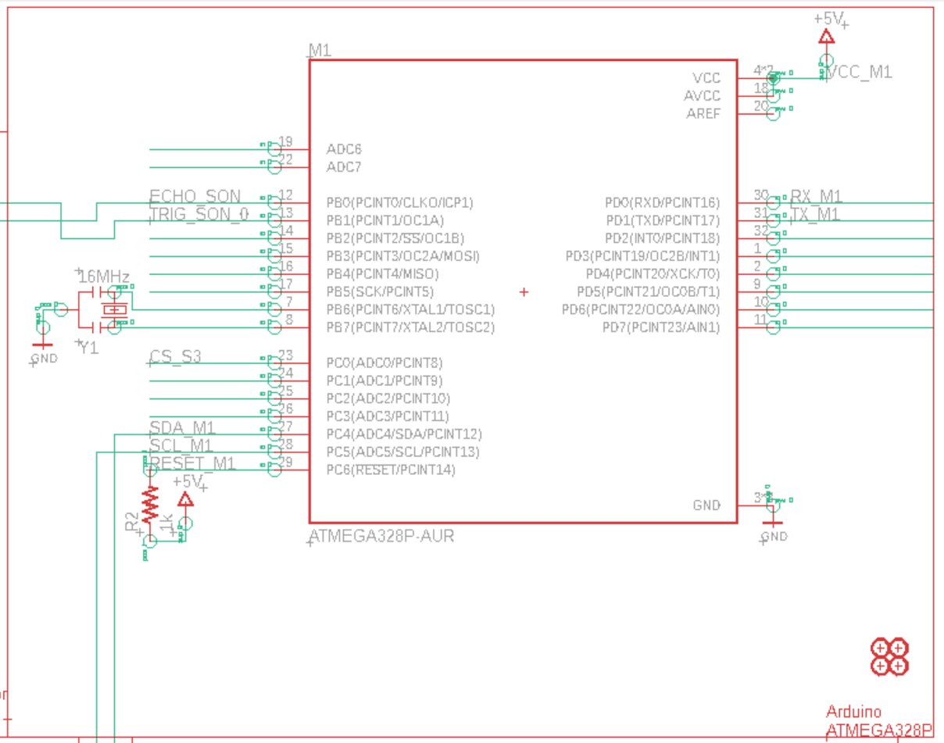
ATMega328P Microcontroller

Slide 15
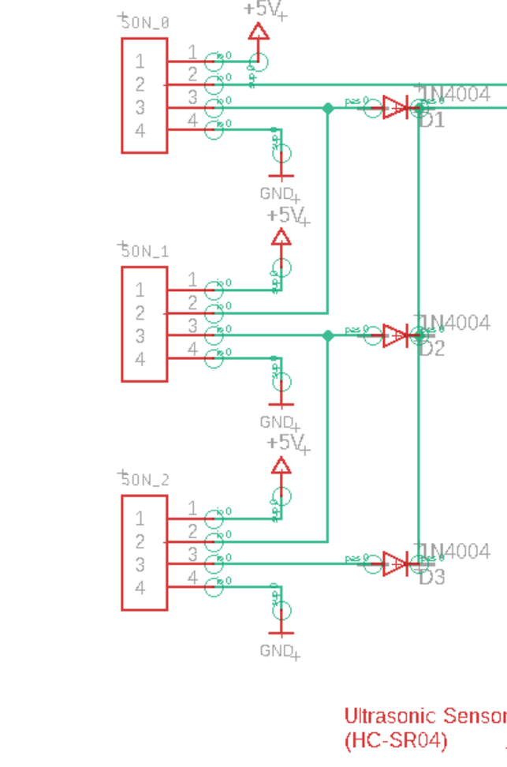
HC-SR04 Ultrasonic Sensor

Slide 16
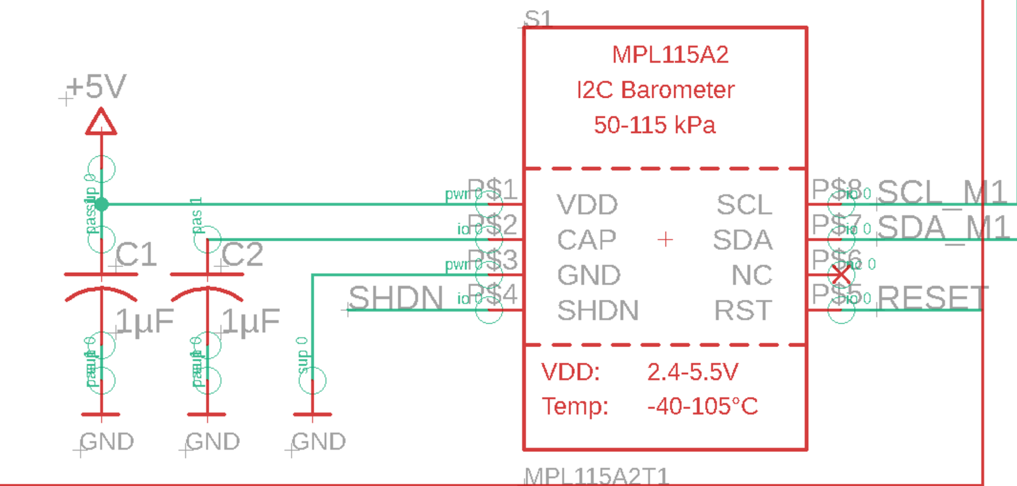
MPL115A Barometer

Slide 17
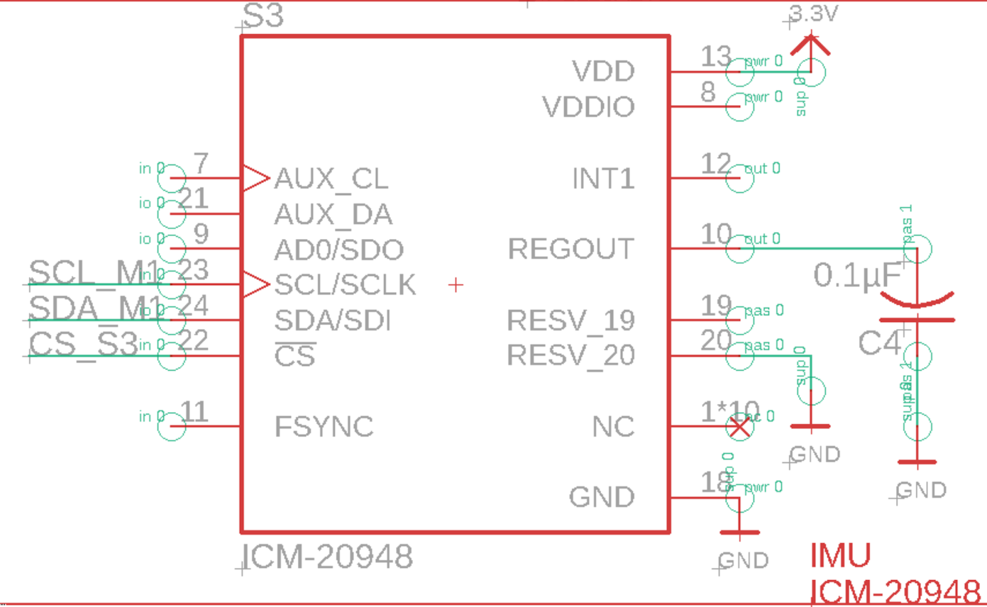
ICM-20948 IMU

Slide 18
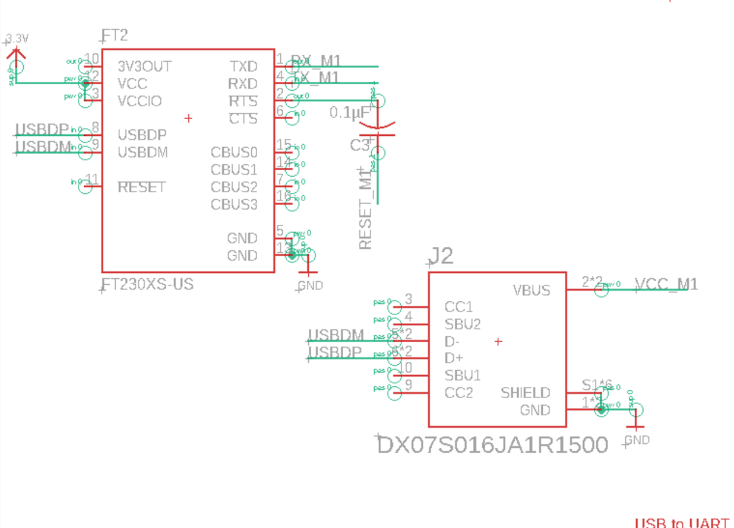
FT230XS USB to UART

Slide 19
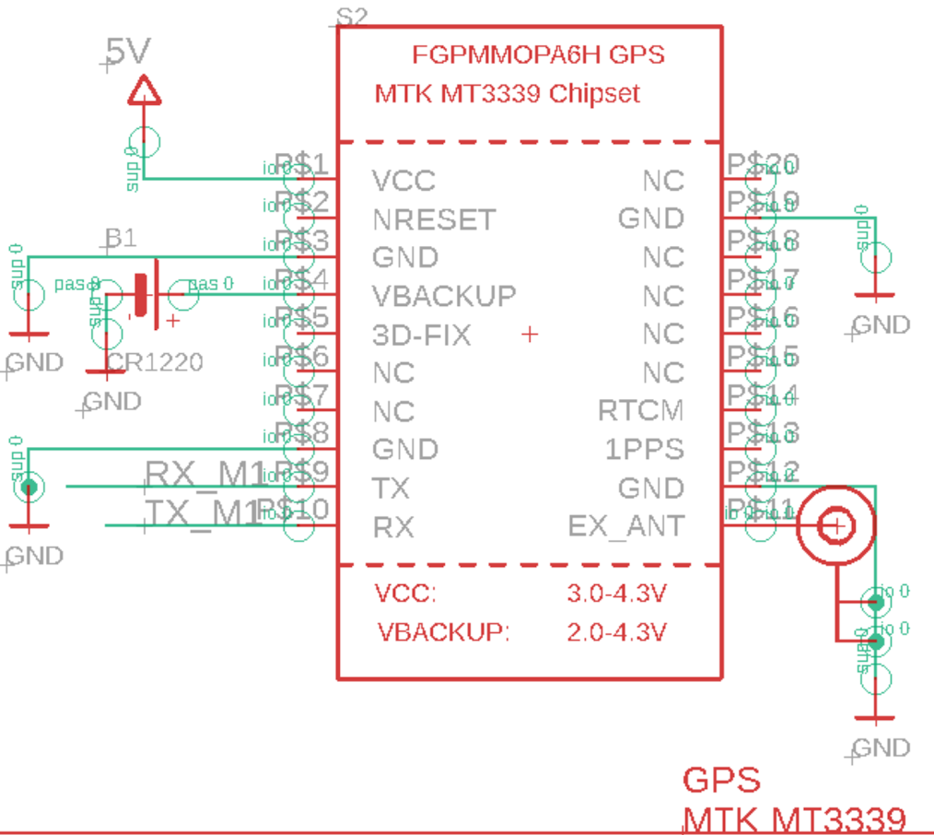
MTK MT3339 GPS Module

Slide 20
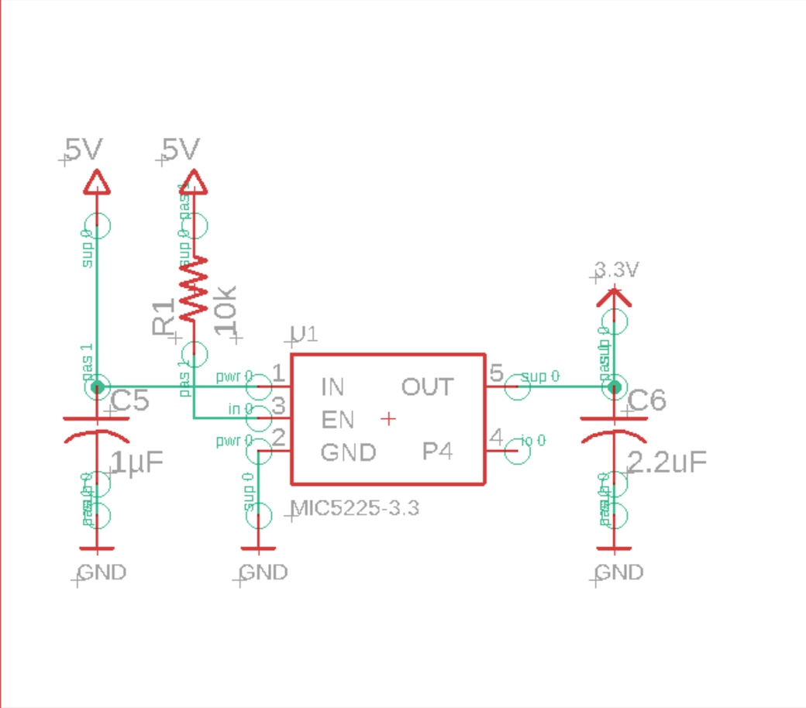
MIC5225-3.3 Voltage Regulator

Slide 21
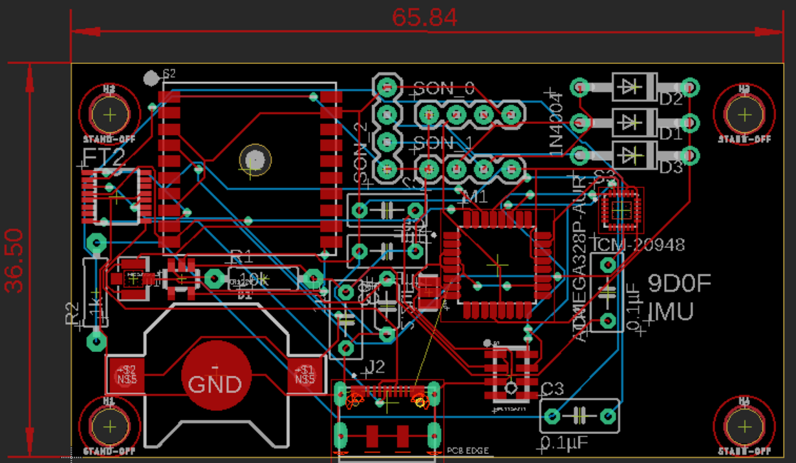
mm
mm

Slide 22
Improvements
Use the space below to reduce board size
Use surface mount devices to reduce space used on both sides
Integrate Raspberry Pi BCM2535 IC
Integrate camera sensor for Raspberry Pi
Connect ECU data pins to Raspberry

Slide 23
Hardware
System Technical Requirements:
Power usage (1.1.1)
RC Control (3.0.0)
Autonomous Controls Systems (4.0.0)
Cost (5.2.0)
Hardware bought:
Microcontroller
Microprocessor
IMU Sensor
Ultrasonic Sensor
Barometric Sensor
GPS Sensor

Slide 24
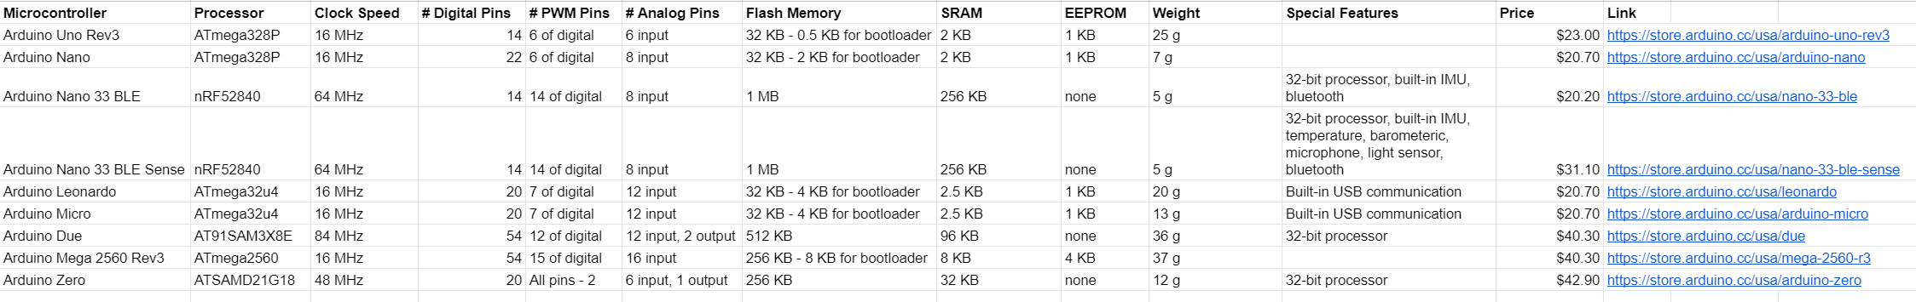
Hardware: Microcontroller

Slide 25
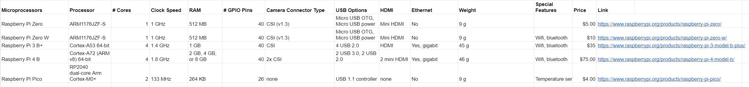
Hardware: Microprocessors

Slide 26
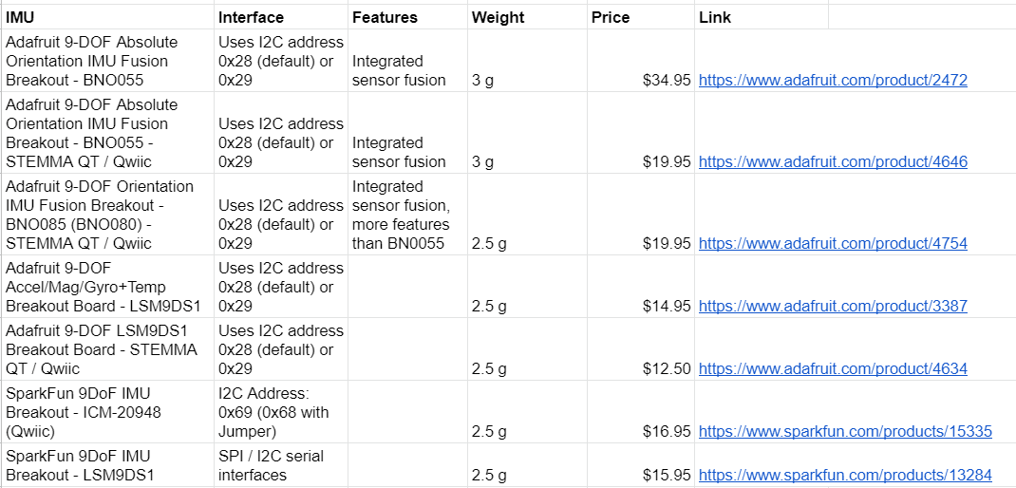
Hardware: IMU Sensor

Slide 27
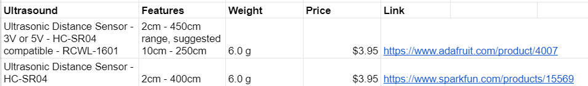
Hardware: Ultrasonic Sensor

Slide 28
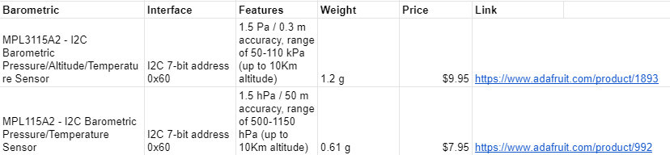
Hardware: Barometric Sensor

Slide 29
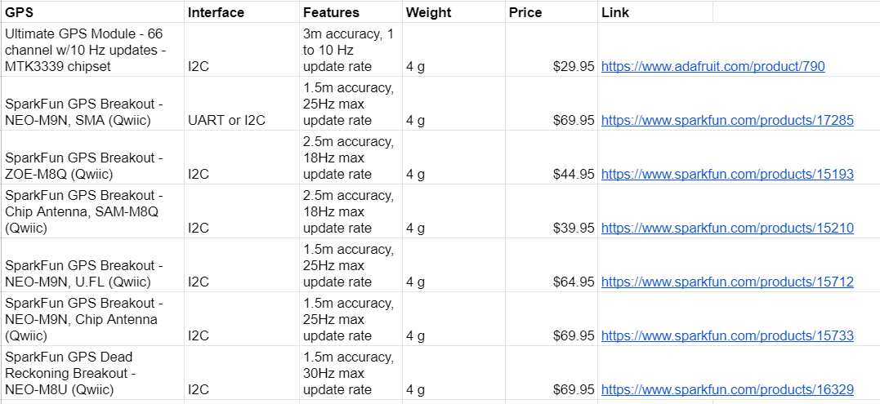
Hardware: GPS Sensor

Slide 30
Hardware: Next Step
Receive Arduino, Raspberry Pi, and sensors bought
Learn how to have Arduino interact with sensors
Learn how to have Raspberry Pi interact with Arduino
Learn how to calibrate sensors
Implement usage of all sensors at once
Implement automatic calibration of sensors

Slide 31
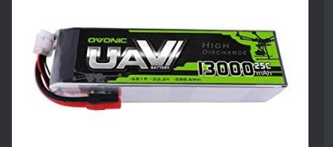
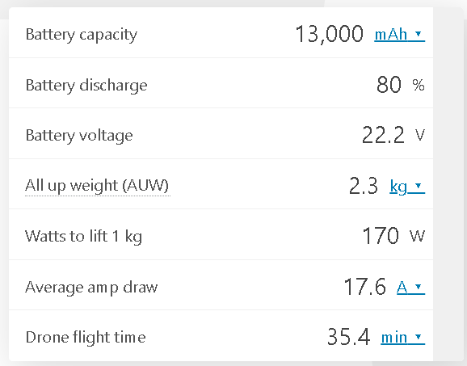
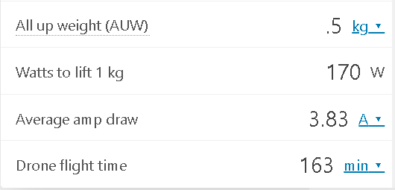
Power Management
Success Matrix Requirements:
1.0: Drone Flight Time, 1.1 Power Usage, 2.0 Drone effective weight,
5.0 Cost
Calculator to predict total flight time using minimalistic inputs
Weight should be considered following sample case:
More in-depth analysis required for peripheral power draw
Analyze each part in BoM
PCB schematics to test different inputs

Slide 32
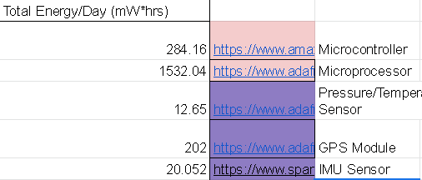
Power Management with BoM
Analyze how much power each part needs(Motors, Microcontroller, etc.)
Power Management chart, with all parts necessary, should be similar to the time estimated in previously
Focuses on datasheets of parts
Nominal Voltage and Amp Draw are expressly focused on
Allows calculation of mA*hrs, mW*hrs, and max power draw (mW)
mW*hrs will be compared with battery supply to get estimated flight time

Slide 33
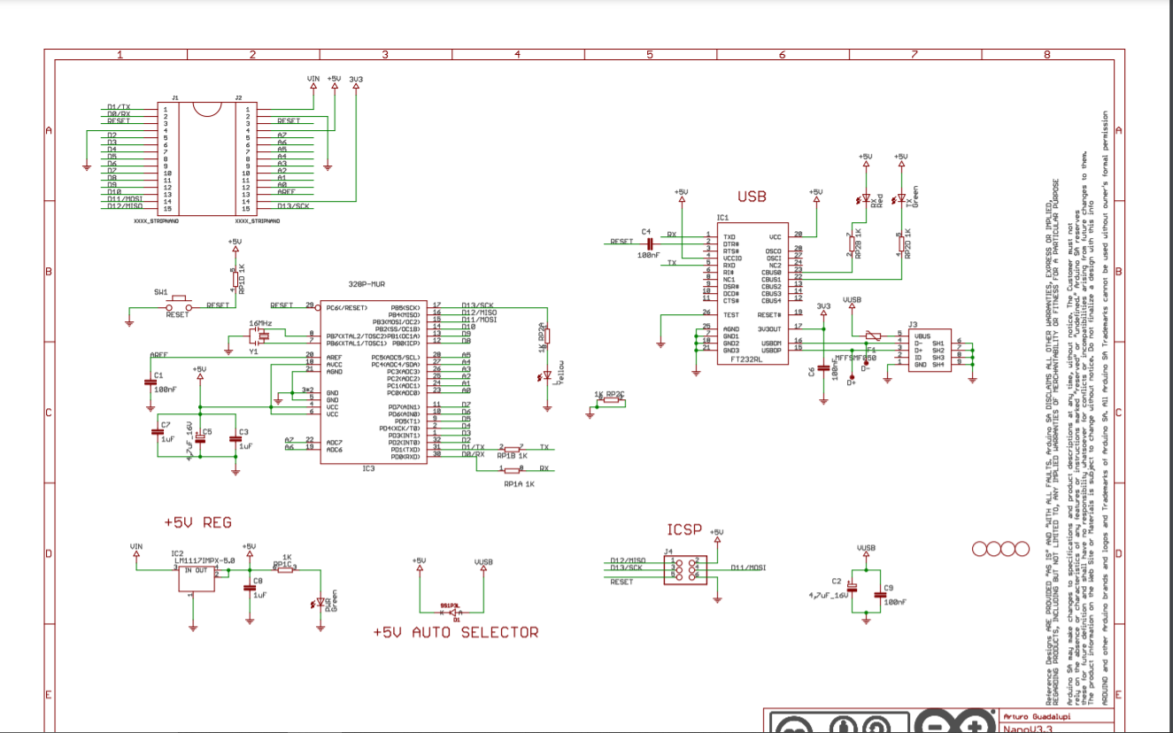
Power Management with PCB
With PCB, the peripherals can all be looked at operating together
Nothing done yet, but will be the focus of future design work for me
Using Eagle CAD with assistance from Ryan

Slide 34
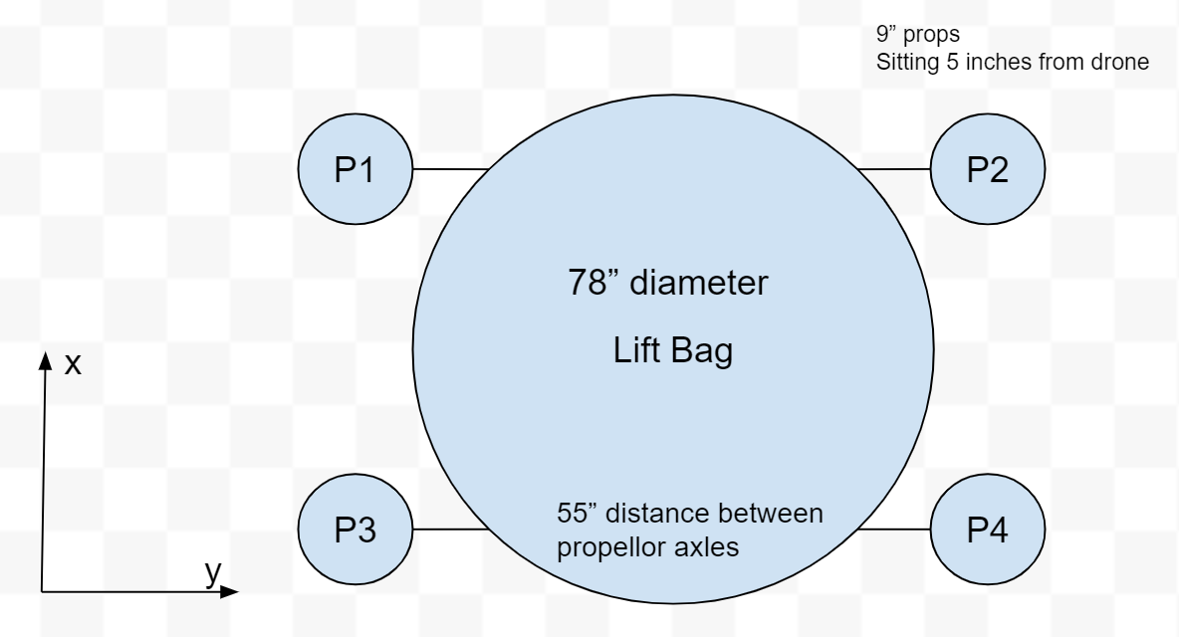
Force Analysis
Net Forces Fnet=Flift+ΣMₓPx*Tₓ
Mnet = FB*(R*CB)+ΣFmx*(CMx+MxPx*d)
FDrag=Cd⍴V^2/2 *A
Fprop/motor=1.225(.0254d)^2/4 * (0.0254RPMprop*pitch)^2

Slide 35
Programming Approach 3.1.1
The speed of the software is critical to minimize the necessary power for embedded circuitry as well as maintaining high levels of accuracy
Necessary computations will be written in C libraries due to simplicity
The arduino language will be used for the main function of the onboard programming since it is already set up for the arduino board and has sensor libraries.
C libraries are also able to be called by many other languages so they can be called on for simulations. However, we should avoid hardware specific code

Slide 36
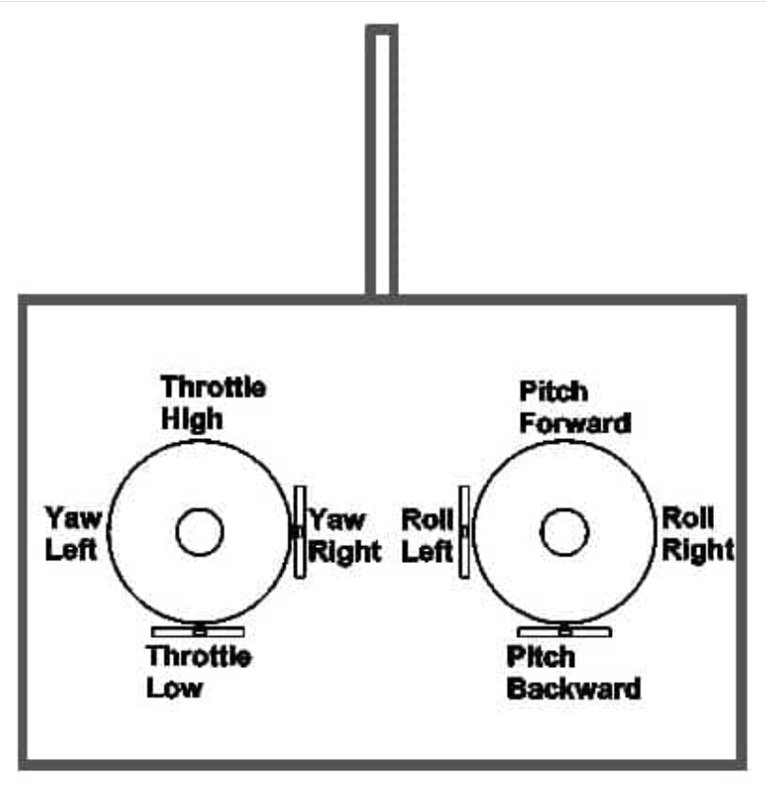
RC Response 3.1.2
Typical Controls rely on tilting drone
We have a buoyancy moment
We need to control the angle of the motors
Descend is not lower throttle but different theta
Controls for throttle, forward, turn, and descend
Theta = pi / 2 * (forward +- turn) / (1 + |forward * turn|)

Slide 37
Factors to consider in autonomous design 4.0.0
Path Following 4.1.0
Terrain Tracking 4.2.0
Error Handling 4.3.0
Crashes
Low battery
Sensor failure
Planning new routes in emergencies 4.6.0
Throttle Optimization? 1.3.0
Auto Landing 4.5.0
State estimation 4.3.2

Slide 38
Sensors
Ultrasonic Sensors 4.2.1
For terrain tracking and auto landing
GPS 4.1.1
For positional accuracy
9DOF 4.3.1
For state estimation, crash detection, and detecting potential problems
Pressure sensor 8.1.1
Determine bag volume

Slide 39
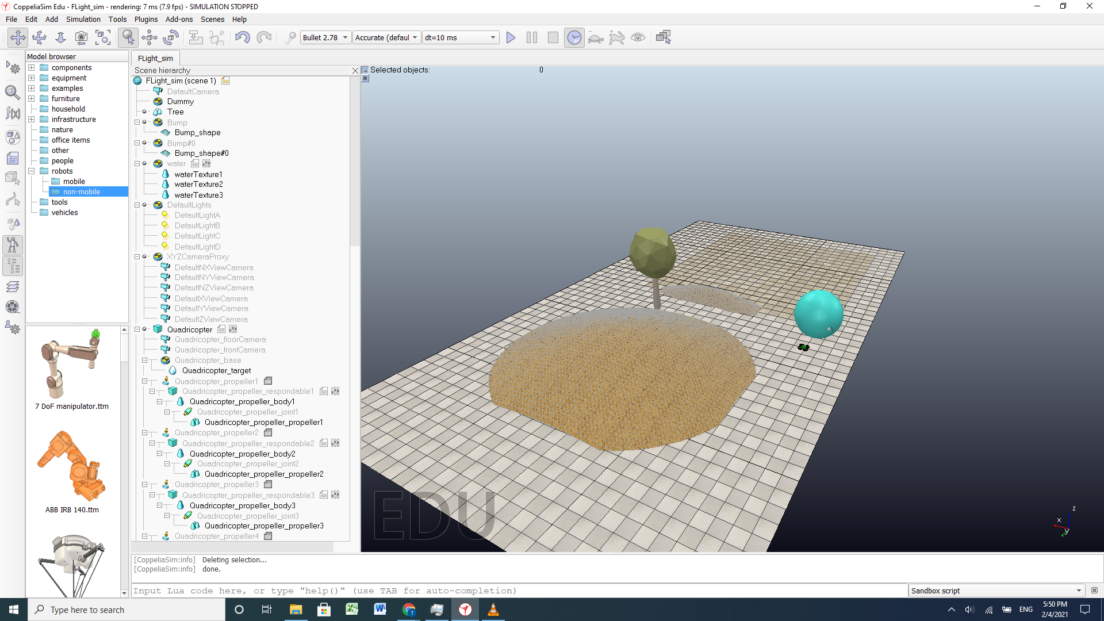
Simulation environment
Decided on Gazebo at first, but due to OS constraints chose V-rep. (Gazebo is a Linux based machine)
V-REP is the "Swiss army knife" among robotic simulators since it has more functions, features and more elaborate APIs than any other software but with very little focus on drones in particular.

Slide 40
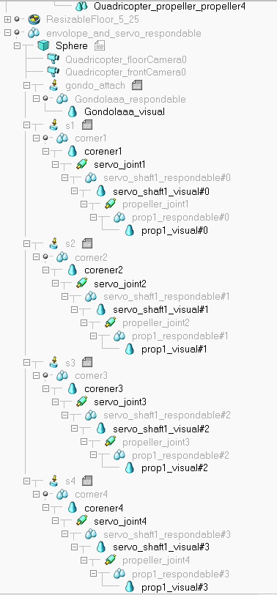
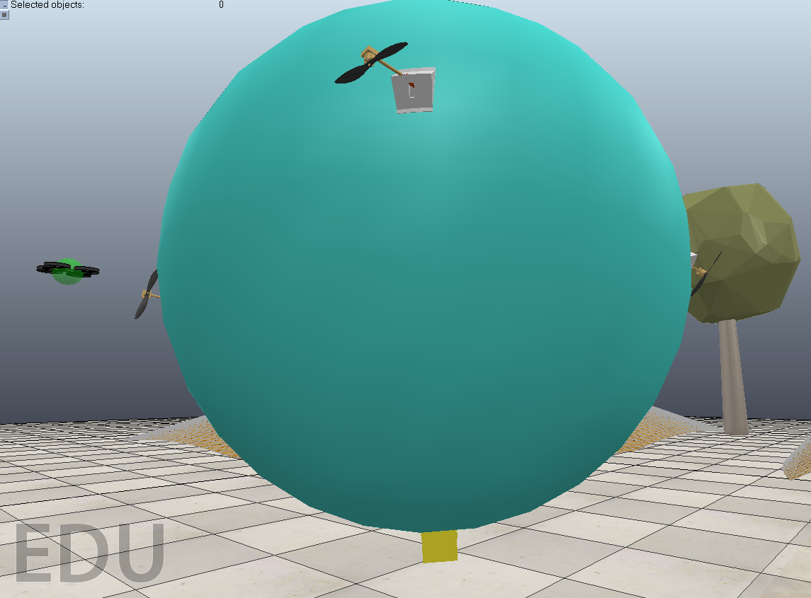
Render CAD Model Within V-rep Simulation
Each part includes a respondable and joint to attach the part to the rest of the parent frame as shown to the right
Wrote in the mass of each object into their object Properties
First CAD design import had some trouble with importing through URDF files so the circle model above was made using native objects with individual CAD parts imported(propellers, corners, shaft, gondola). The benefit to using native objects is that Pure simple shapes are best suited for dynamics collision response calculation, since it will perform more quickly and more stable.

Slide 41
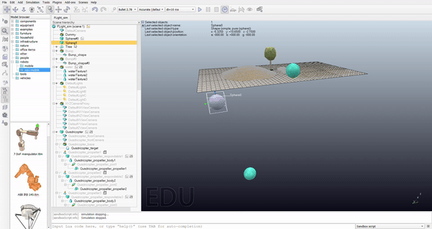
Simulation Next Steps
Create buoyancy within a non-buoyant environment
Implement Servo Movement
Implement Propeller Forces
Uses particles to accelerate objects
Implement Drag Forces on the Balloon
Add Sensors to the Envelope and Gondola
System Technical Requirement: Validates that many system technical requirements meet requirements
The goal is that our simulated drone runs better than the provided model drone, and simulates as close to actual drone testing within a real-life environment.
Two spheres of the same mass and volume but the one on the right has buoyant properties coded in

